Slide 1
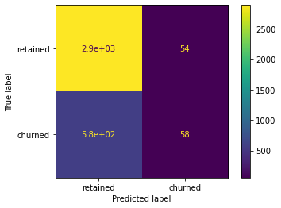
Waze Churn Prevention
Regression Model
Project Overview
This report contains information regarding the correlations between the data, and the results of a logistic regression model.
activity_days has the strongest influence on user churn
Model has decent precision (52%), but very low recall (9%)
Would not recommend the use of this model
May need to create a new model with different features
Several variables contain outliers that were changed to their 95th percentile value
Categorical variables (label and device) were encoded:
label (retained = 0, churned = 1)
device (Android = 0, iPhone = 1)
Multicollinearity exists:
sessions and drives
activity_days and driving_days
Use different features or scaling to create a possibly better logistic regression model
Create a machine learning model to predict churn

